Slide 1
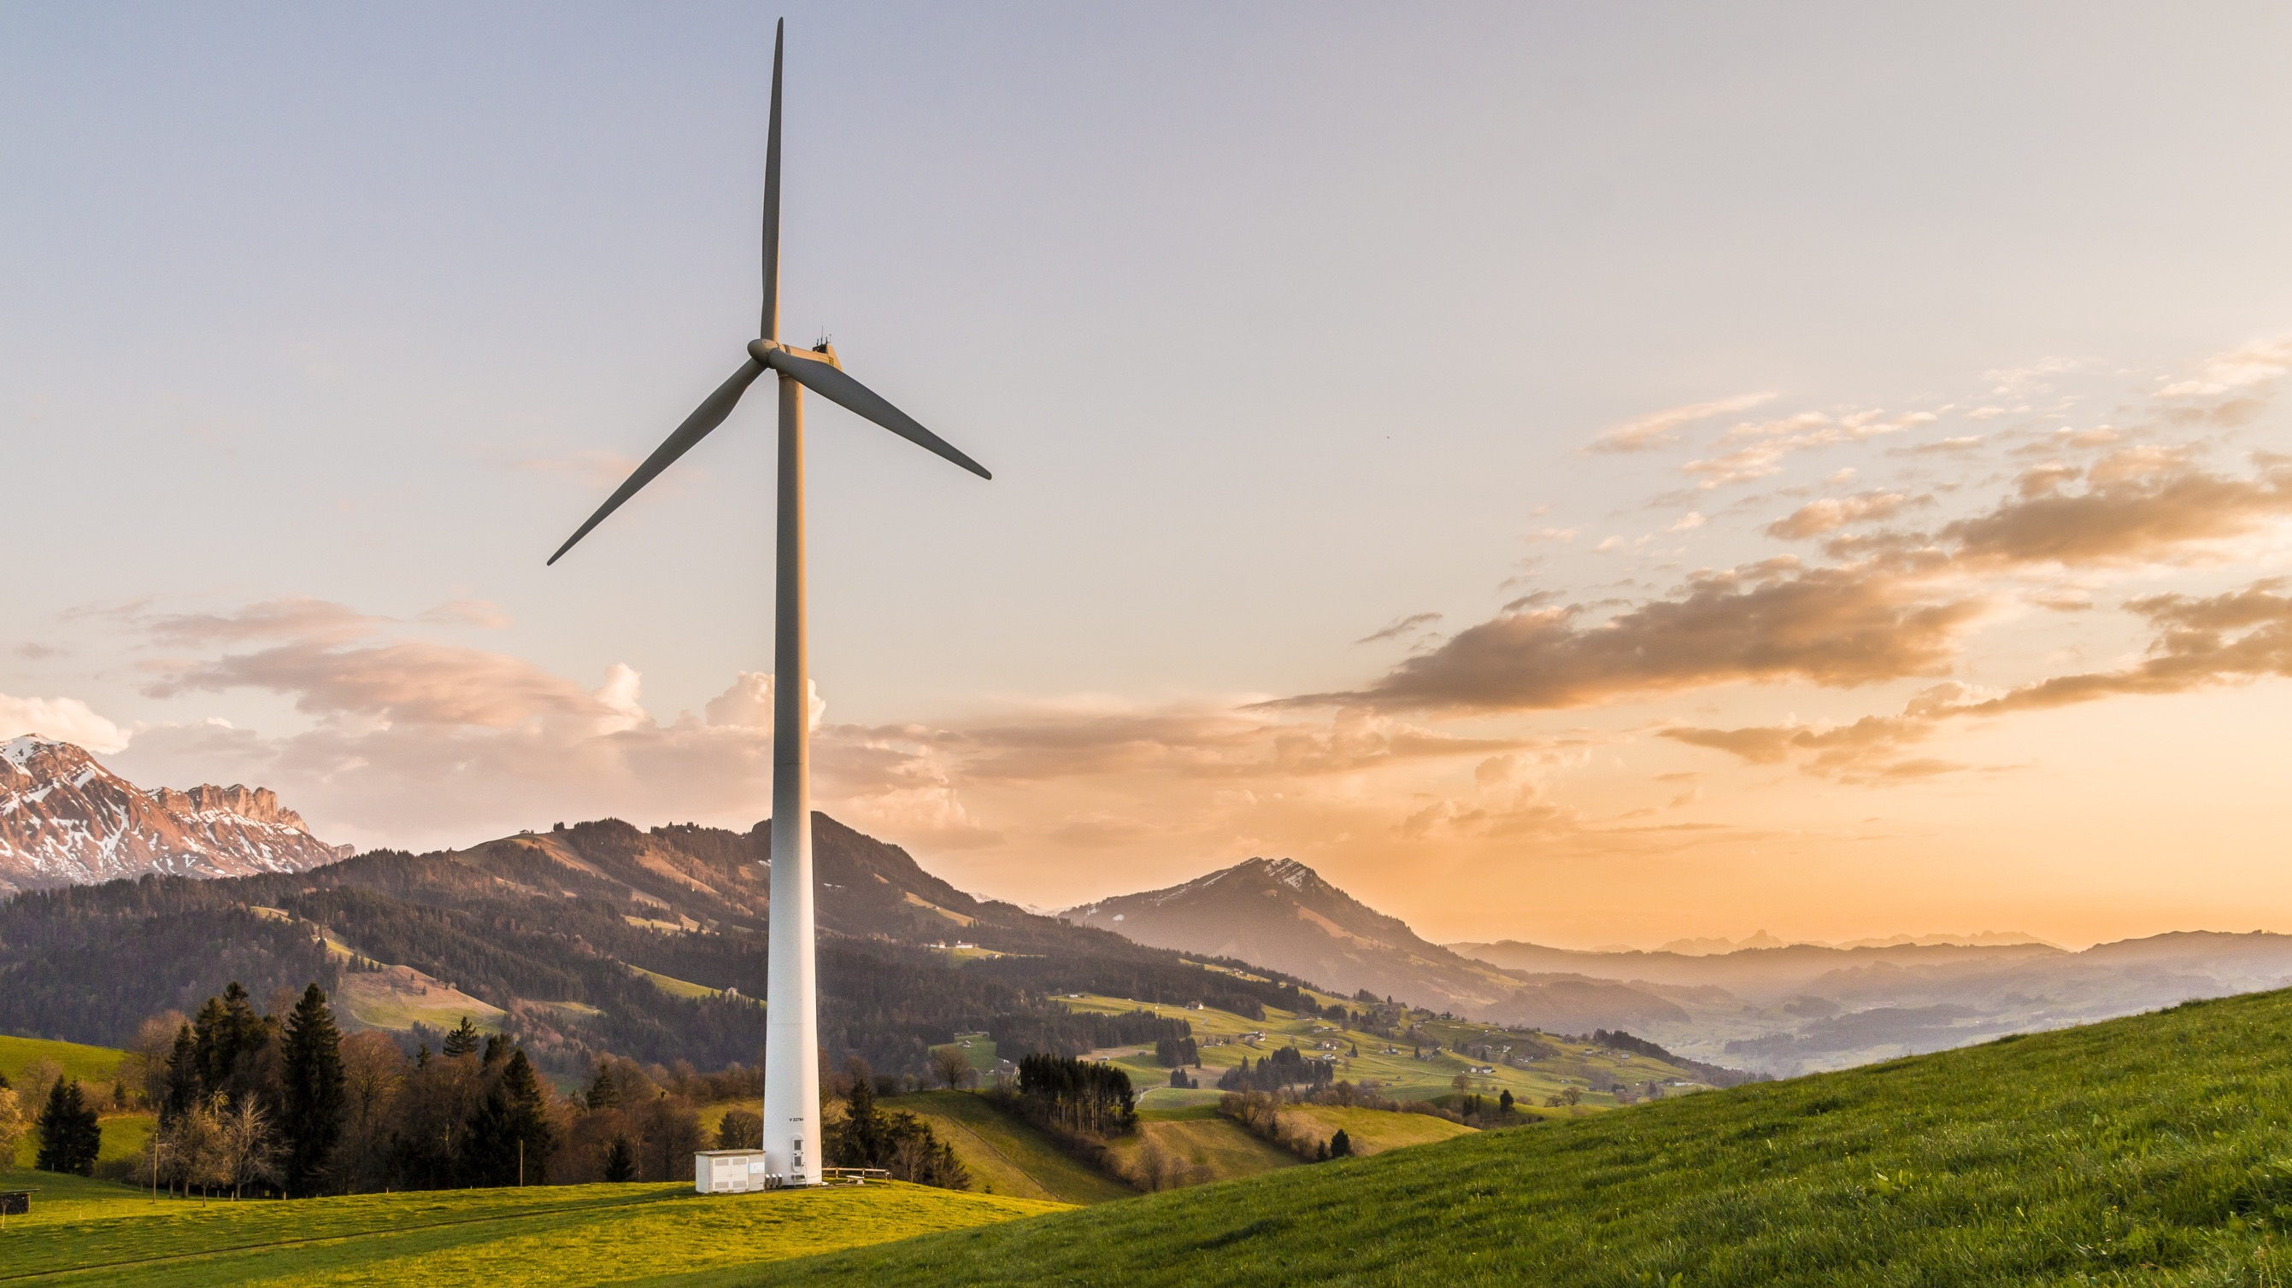


ELECTRIFYING
HOY ISLAND
BCPT-404 7A/B
Group 4 [Community];
Group 5 [Conservationists];
Group 6 [Developers];
Jaismine 100186158
MSP CHALLENGE

Slide 2
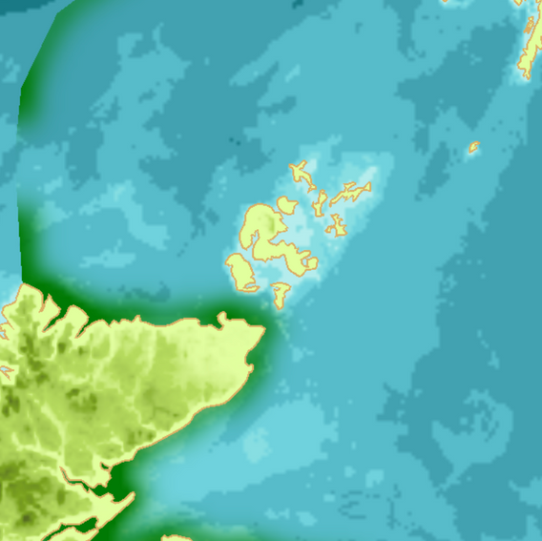
WELCOME & INTRODUCTION
Welcome to the stakeholder consultation meeting
Purpose: To collaboratively decide how to bring power to Hoy Island
Hoy currently has no energy infrastructure
We are joined:
Energy Developers
Conservationists: marine protection focus
Community Representatives: social, local economic priorities
We will present Plan A, then three alternatives, and gather feedback on each

Slide 3
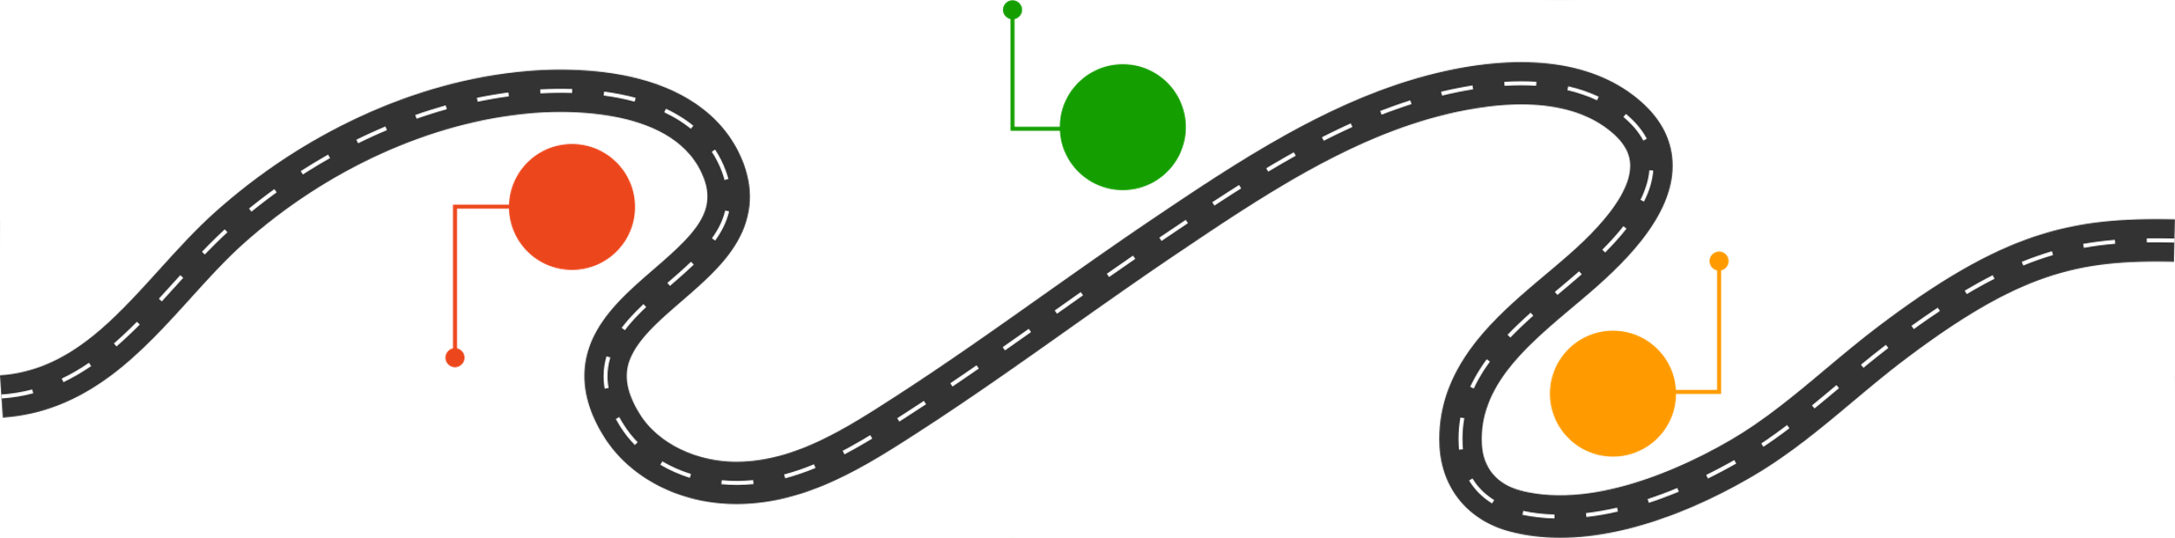
Agenda
Problem
Discuss Solution
Alternative 1
Alternative 3
Stakeholders Arguments
Stakeholders Arguments
02
04
06
03
07
01
05
Plan
Arguments
Alternative 2
Stakeholders Meeting
Stakeholders Arguments
Final Plan

Slide 4


STAKEHOLDERS INVOLVED
Why project management and stakeholder communication are important
Expected outcomes of implementing this strategy
Developers: Engineers and planners
Conservationists: Protect marine ecosystems, MPAs, and biodiversity
Community Representatives: Represent Brims Island’s local residents
We value open, constructive feedback
Everyone will be heard before final decision is made

Slide 5
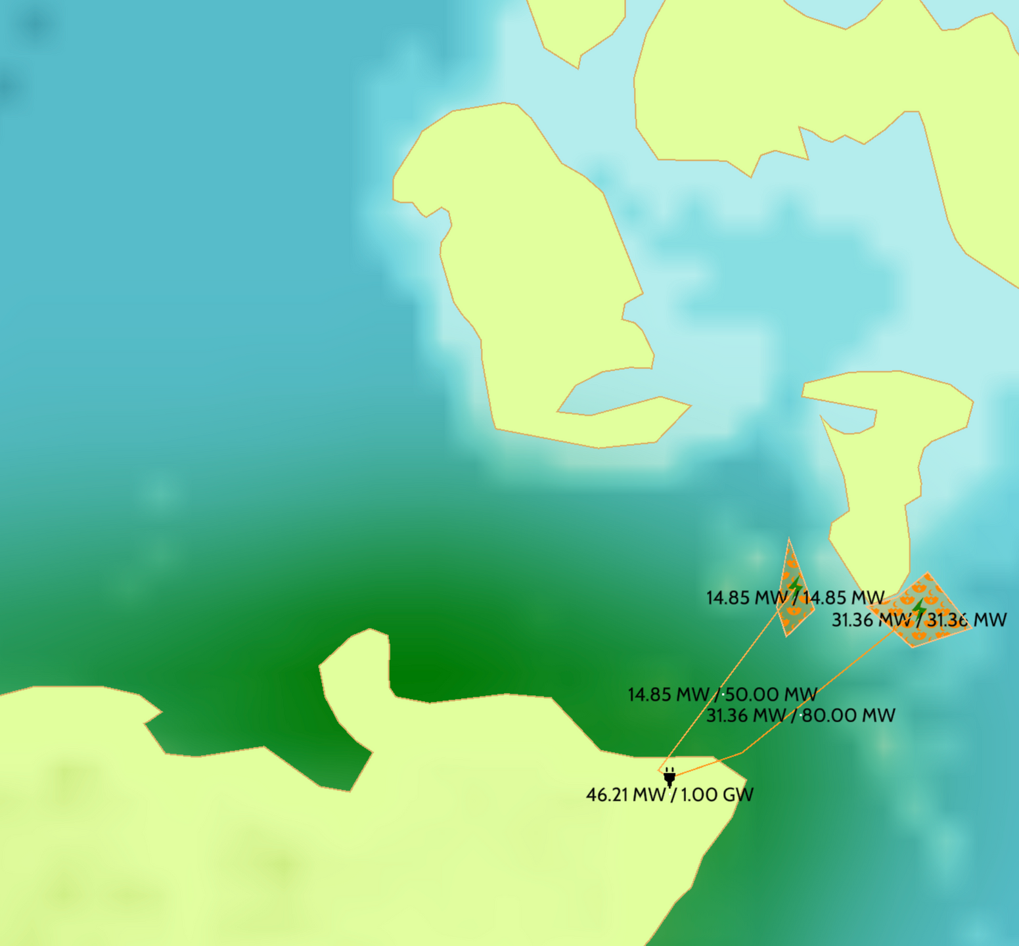
The Problem
Brims
Brims [Hoy] Island has no power source
There’s a pressing need to power homes, businesses, and infrastructure
Our role: deliver clean, reliable energy with minimal environmental and social conflict
Stakeholders’ input is crucial in choosing the best plan
Goal: reach a consensus on the best plan
⦿
⦿
Gills, UK

Slide 6
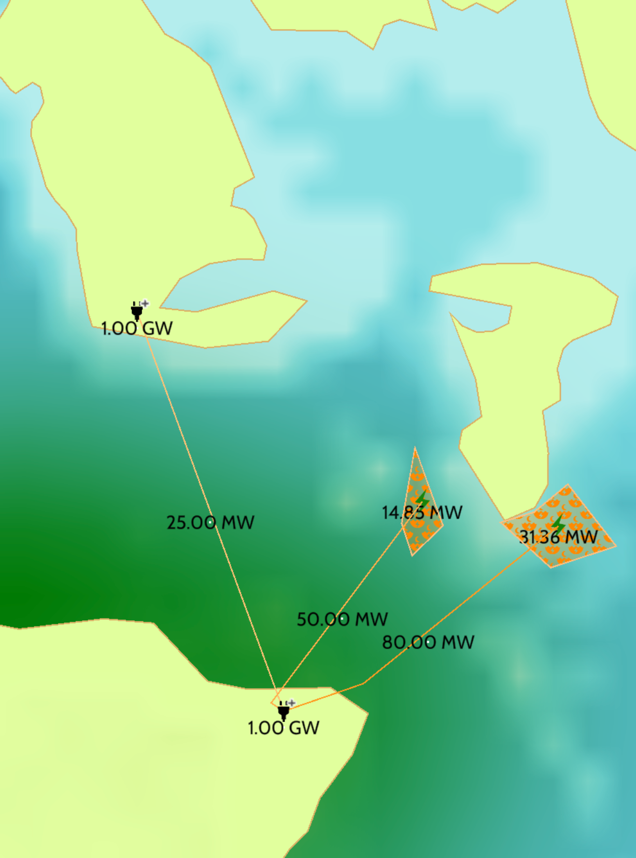

PLAN
UNDERSEA CABLE FROM GILLS BAY TO BRIMS ISLAND
DISTANCE: 17.66 KM UNDERWATER
CAPACITY: 25 MW
USES EXISTING LANDING STATION AT GILLS
NEW LANDING STATION TO BE BUILT AT BRIMS
INTENTION: DIRECT, SIMPLE SOLUTION FROM MAINLAND TO ISLAND

Slide 7
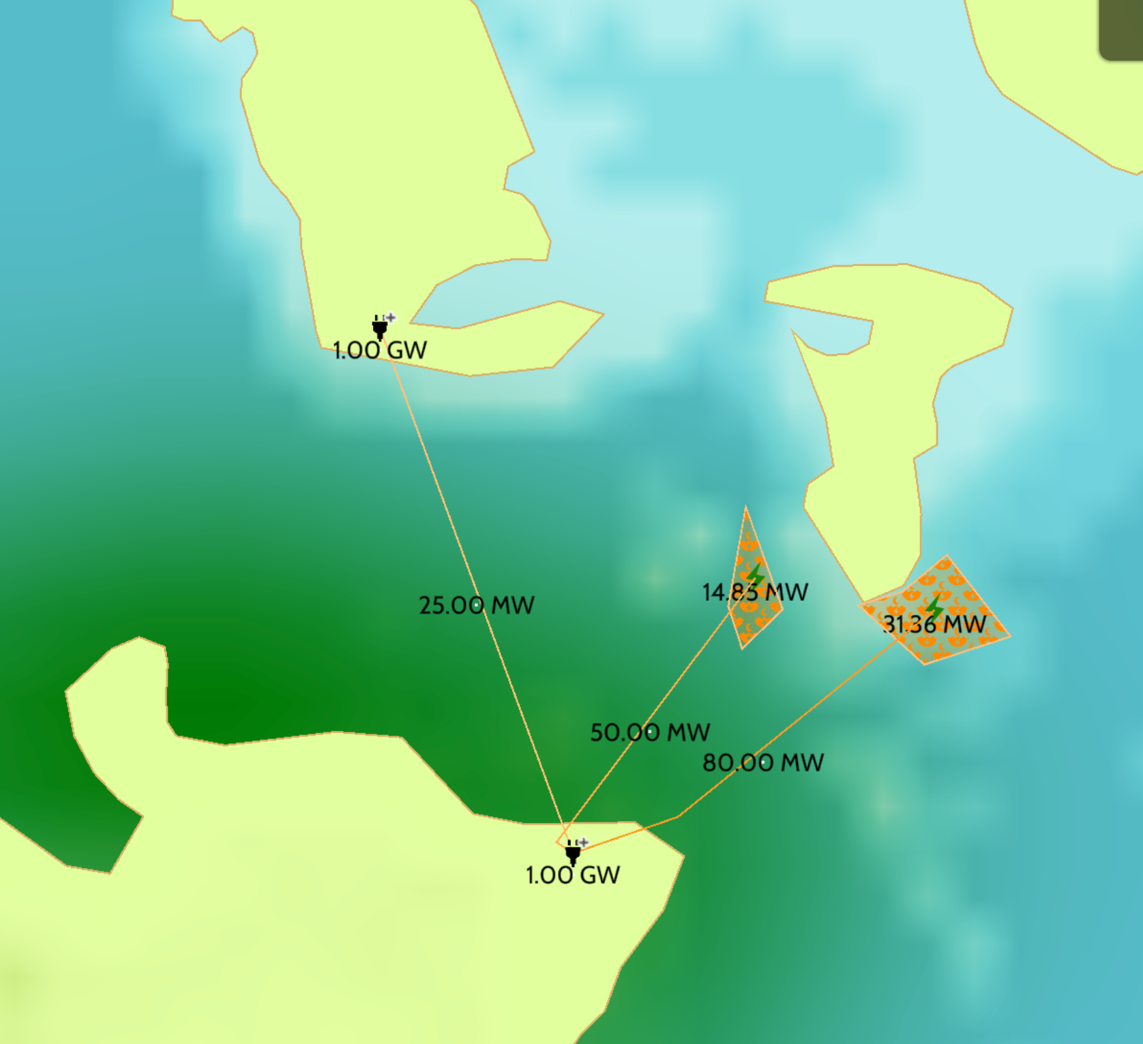
PLAN : KEY POINTS
Crosses Marine Protected Area (MPA)
Cuts through high-density fishing zones
Intersects with a commercial shipping lane
Hard and uncategorized seabed makes cable laying difficult
Long cable = higher transmission loss and increased maintenance
Risks: regulatory pushback, ecological harm, stakeholder opposition
“Conversation with the Environmentalists.”

Slide 8
COMMUNITY PERSPECTIVE
DESCRIPTIVE
What marine activities do local communities depend on along the cable route, and how might construction interfere with those activities?
5 Questions We Will Tackle:
PREDICTIVE
How might construction or presence of the cable affect marine conditions that support livelihoods
PRESCRIPTIVE
What are the trade-offs for communities if the plan moves forward as designed — in terms of access, safety, and day-to-day activities?
LOCATION ANALYTICS
Where are areas of high marine use or value to communities that should be treated with caution during cable installation?
STAKEHOLDER IMPACT
What long-term benefits does the plan offer to nearby communities ?

Slide 9
CONSERVATIONIST PERSPECTIVE
DESCRIPTIVE
What is the current density of benthic invertebrates, sandeels, and large fish along each cable route?
5 Questions We Will Tackle:
PREDICTIVE
What are the long-term ecological impacts of cable construction on seals, cetaceans, and biodiversity?
PRESCRIPTIVE
Which mitigation strategies should be prioritized to reduce ecological damage?
LOCATION ANALYTICS
Where can cable routes be placed to fully avoid protected areas and high-biodiversity zones?
STAKEHOLDER IMPACT
How can we ensure biodiversity protection through effective monitoring systems during and after the project?

Slide 10
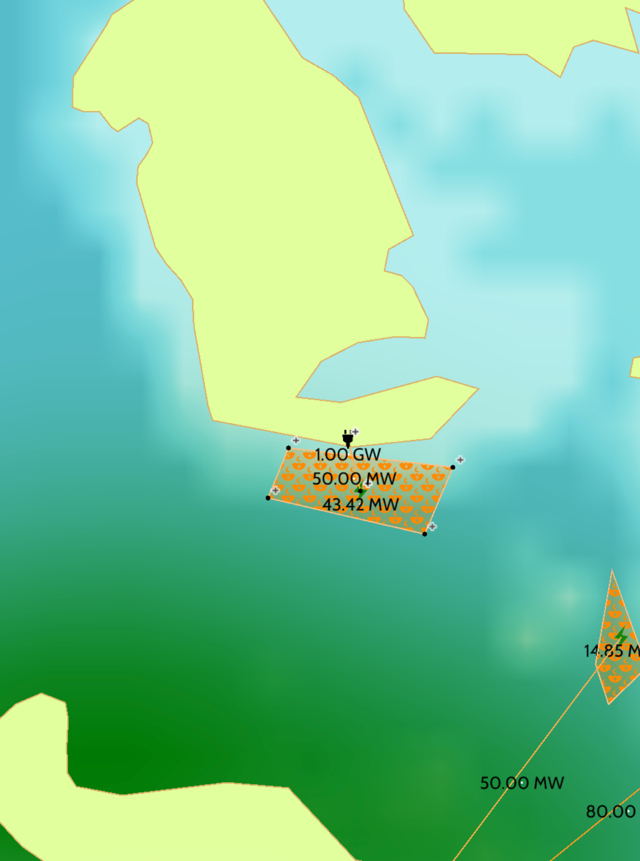
ALTERNATIVE 1: LOCAL TIDAL FARM
Install tidal energy farm near Brims
Cable: 2.09 km, 50 MW capacity
Connects directly to a new landing station on Brims
Brims becomes self-sufficient
Avoids MPA and shipping lanes
The farm covers (6.45 km × 2.05 km)
Brims
⦿

Slide 11
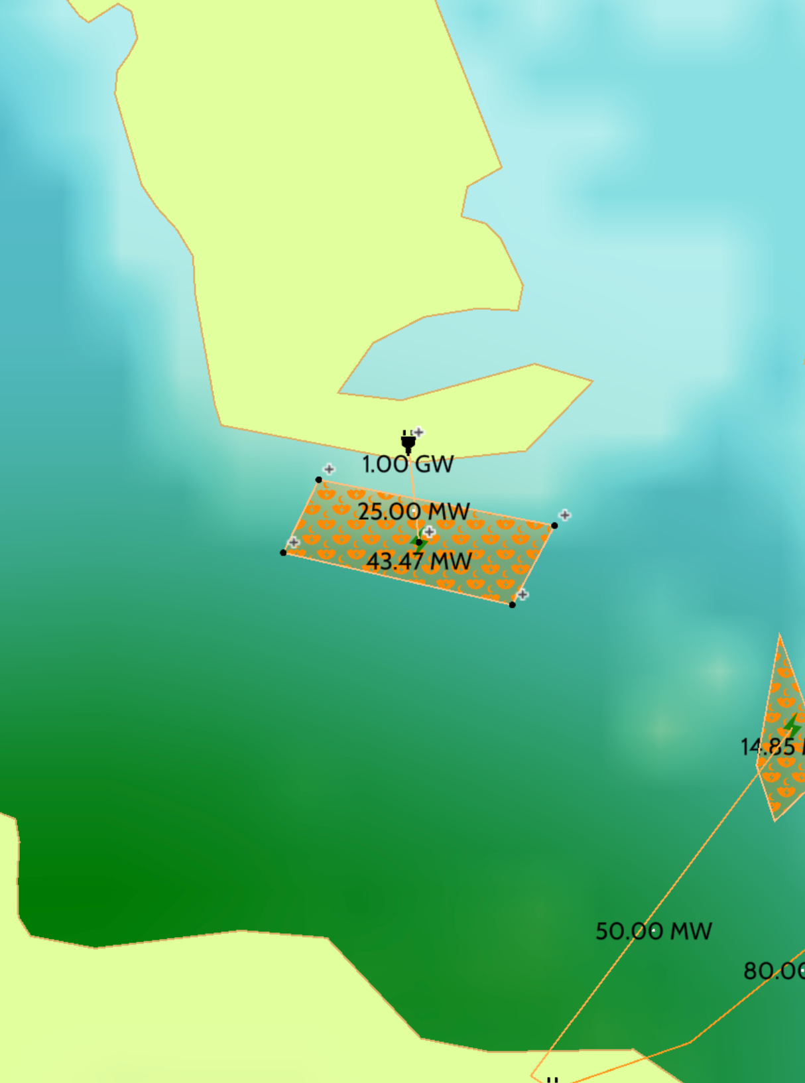
ALT 1: TECHNICAL & ENVIRONMENTAL
Brims
Simplest setup: 1 farm, 1 landing station, short cable
Seabed is uncategorized, manageable with pre-install survey
Environmental risk is limited to fishing activity conflict
High efficiency due to short distance
⦿

Slide 12
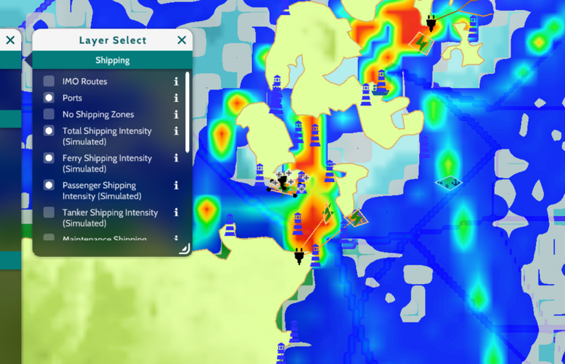
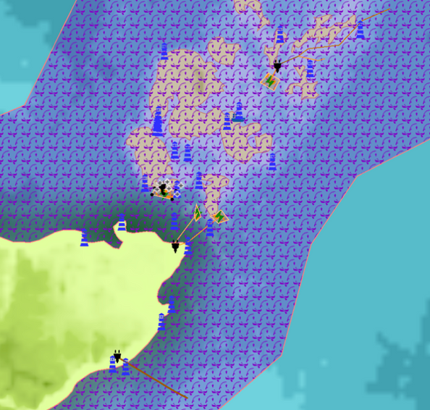
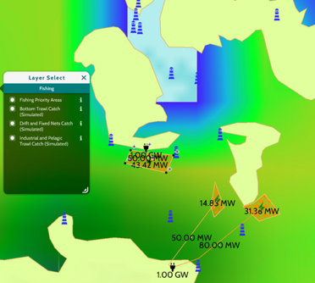
ALTERNATIVE 1 : COMMUNITY POV
DESCRIPTIVE:
Question:
Response:
What marine activities do local communities depend on along the cable route, and how might construction interfere with those activities?
Recreational and tourism uses
Inshore fishing
Recreational and tourism uses
PREDICTIVE:
Question:
Response:
How might construction or presence of the cable affect marine conditions that support livelihoods, like fish availability or safe access to coastal waters?
Fish and shellfish availability
During installation, the presence of cable ships and temporary marker buoys could alter currents
Fishers may lose access to prime fishing grounds for the duration of the works
STAKEHOLDER TRADE-OFFS
Question:
Response:
What are the trade-offs for communities if this Plan moves forward as designed — in terms of access, safety, and day-to-day activities?
Noise from vessels and equipment might affect the quiet environment
No more worrying about power cuts during the holidays, for instance
Short-term loss of access to certain marine areas

Slide 13
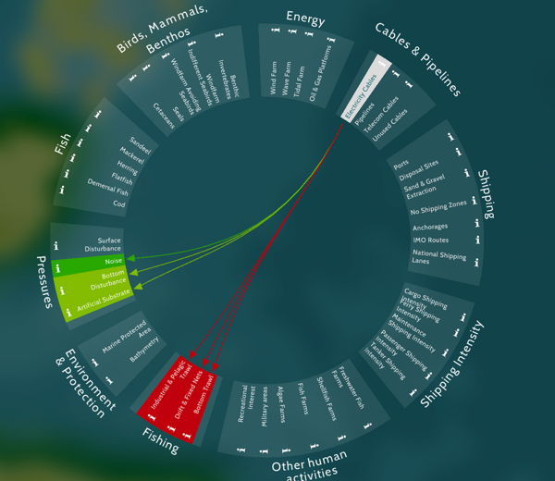
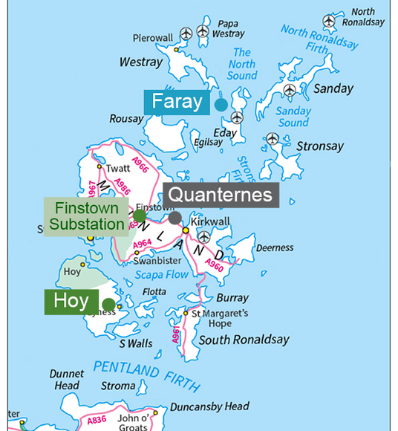
ALTERNATIVE 1 : COMMUNITY POV
LOCATION ANALYTICS
Question:
Response:
Where are areas of high marine use or value to communities that should be treated with caution during cable installation?
Ferry Routes:
Traditional Fishing Grounds
wreck sites
Aquaculture site at Pegal Bay
COMMUNITY IMPACT
Question:
Response:
What long-term benefits does Plan A offer to nearby communities (e.g., improved energy access or economic opportunities), and how can those be measured or ensured?
Energy access and capacity increases
At least £371 million to the Orkney economy
Economic diversification
Environmental benefits

Slide 14
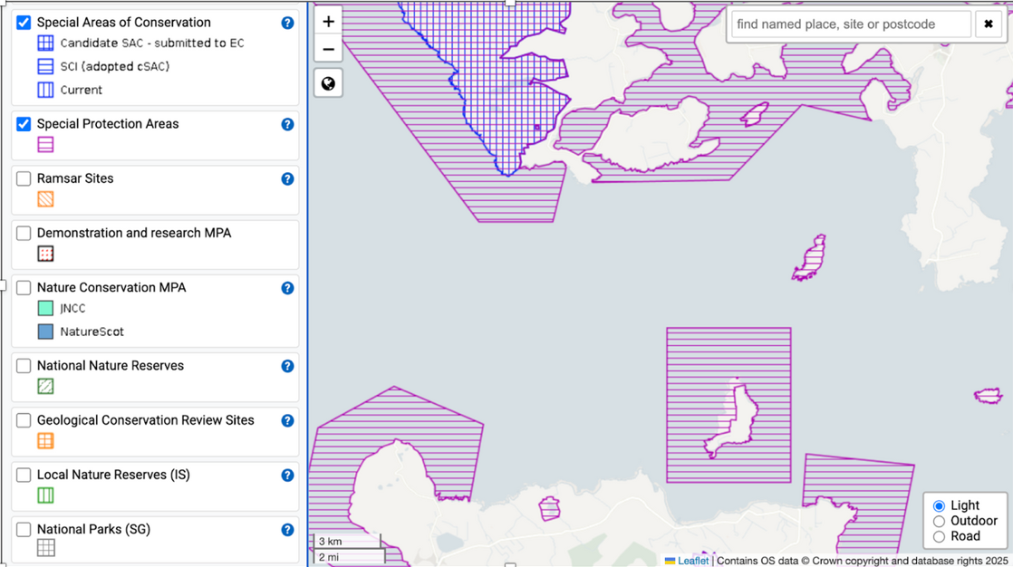
NATIONAL SITE NETWORK
Post-Brexit, UK SPAs no longer fall under the EU Natura 2000 network. Instead, they are now part of the National Site Network under UK law.
This includes the Brims SPA, which remains protected due to its significance for seabirds and marine mammals.
https://sitelink.nature.scot/map

Slide 15
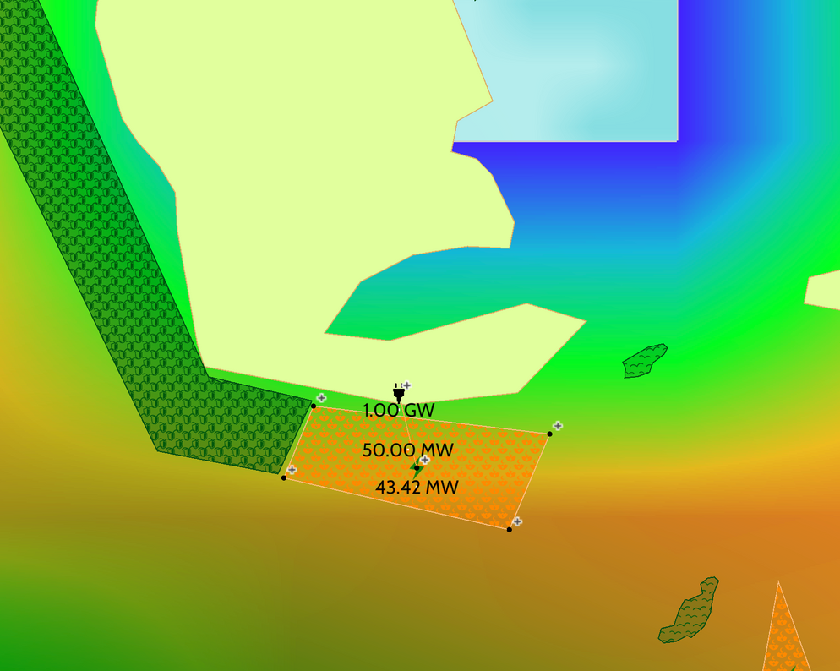



ALTERNATIVE 1 : CONSERVATIONIST POV
DESCRIPTIVE:
Question:
Response:
What is the current density of benthic invertebrates, sandeels, and large fish along each cable route?
Medium benthic invertebrate density
Medium sandeel fish density
Medium large fish density
Tidal Farm borders Natura 2000 (now Special Protected Area)
Brims
PREDICTIVE:
⦿
Question:
Response:
What are the long-term ecological impacts of cable construction on seals, cetaceans, and biodiversity?
Very high impact on seals (route in high-density area) due to noise pollution and EMF radiation
Medium impact on sandeel due to sediment disturbance and cetaceans habitat due to noise pollution
General biodiversity: Moderate to high, especially near the SPA zone
PRESCRIPTIVE:
Question:
Response:
Which mitigation strategies should be prioritized to reduce ecological damage?
Avoid construction during seal breeding and pupping seasons
Use nearshore to reduce disturbance in sensitive coastal habitats.
Deploy acoustic monitoring for cetaceans and visual monitoring for seal haul-outs.
Geo-Layers include: Mammals and Marine Protected Areas
Very High to High Seal Density
Medium Seal Density
Low to Very Low Seal Density

Slide 16
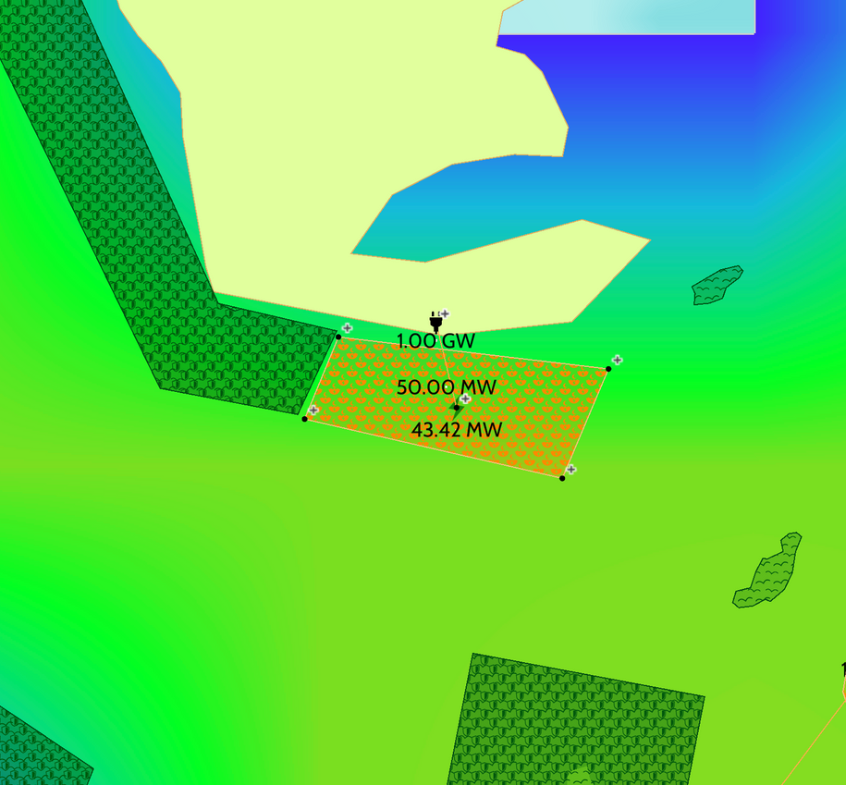
ALTERNATIVE 1: CONSERVATIONIST POV
LOCATION ANALYTICS:
Question:
Response:
Where can cable routes be placed to fully avoid protected areas and high-biodiversity zones?
Borders SPA
Minor route adjustment needed to reduce impact on seal haul-outs.
Avoid sandeel-rich areas using high-resolution habitat data.
Brims
⦿
STAKEHOLDER IMPACT:
Question:
Response:
How can we ensure biodiversity protection through effective monitoring systems during and after the project?
Pre-construction biodiversity mapping essential for baseline data.
Deploy real-time monitoring for seals and cetaceans during work.
Post-installation surveys to assess benthic and seal recovery.
Geo-Layers include: Fish, Macrobenthos, Protected Areas, Biodiversity Indicator

Slide 17
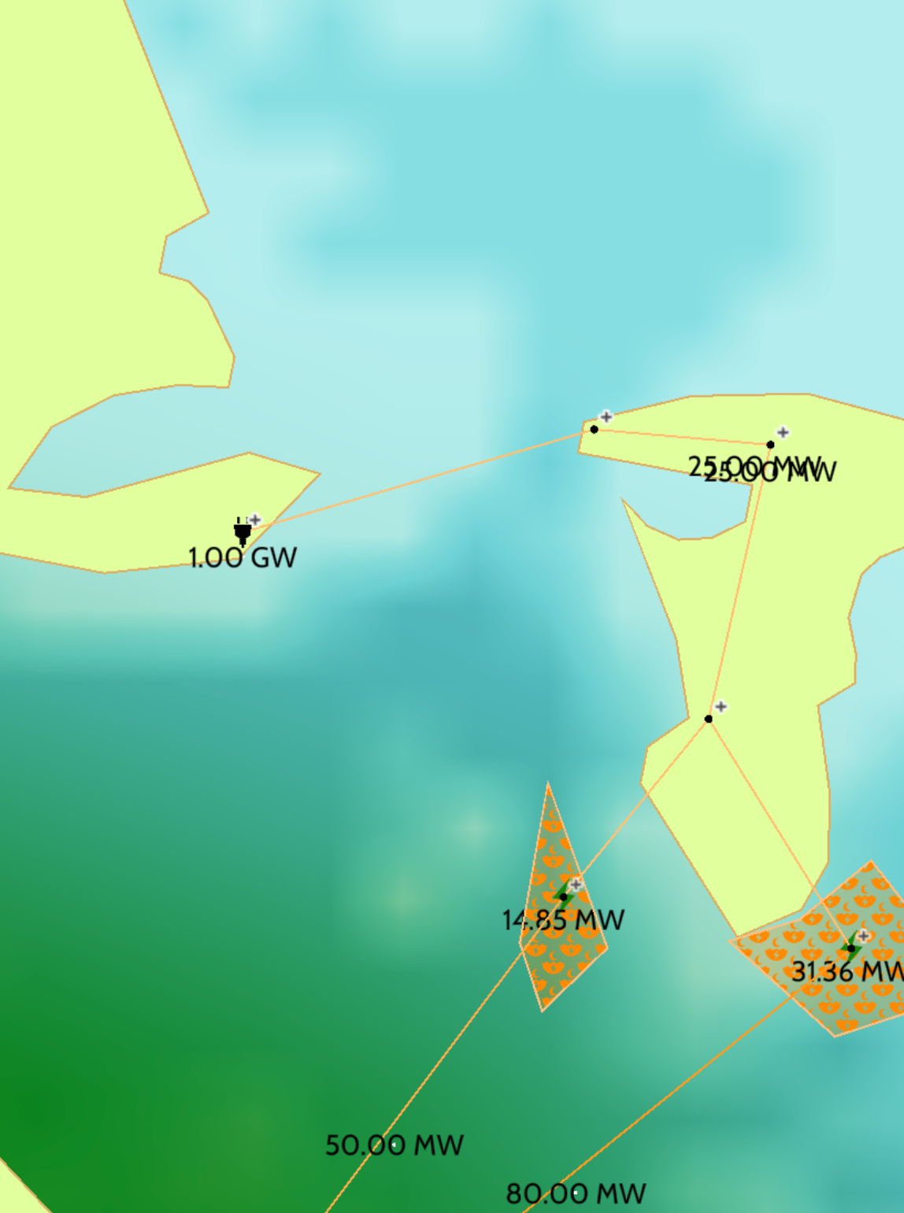
ALTERNATIVE 2: USING EXISTING TIDAL FARMS
Herstone
Brims
⦿
Tidal farms: 14.85 MW + 31.36 MW (mainland side)
Cable route: Burwick → Herston → Brims
Underwater length: 7.18 km
No MPAs or shipping lanes crossed
BUT: passes through high-density fishing zone
Uses existing infrastructure, but requires 4 underwater crossings
⦿
Burwick
⦿

Slide 18
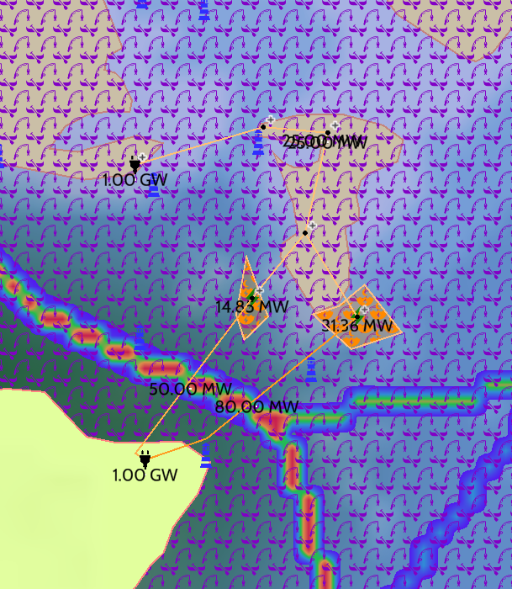
ALTERNATIVE 2 : COMMUNITY POV
DESCRIPTIVE:
Question:
Response:
What marine activities do local communities depend on along the cable route, and how might construction interfere with those activities?
Active tourism and recreational zones used for fishing
Cables cross through passenger , tanker and cargo shipping routes
PREDICTIVE:
Question:
Response:
How might construction or presence of the cable affect marine conditions that support livelihoods, like fish availability or safe access to coastal waters?
Fishing zones could be disrupted due to sensitivity to seabed disturbance,
increased vessel traffic due to construction reducing access of smaller community boats
reduce access and fish availability
STAKEHOLDER TRADE-OFFS
Response:
Question:
Face reduced access to traditional waters
safety risk of navigating near construction vessels.
Fishing, recreational activities being impacted
day to day affected
What are the trade-offs for communities if this Plan moves forward as designed — in terms of access, safety, and day-to-day activities?

Slide 19
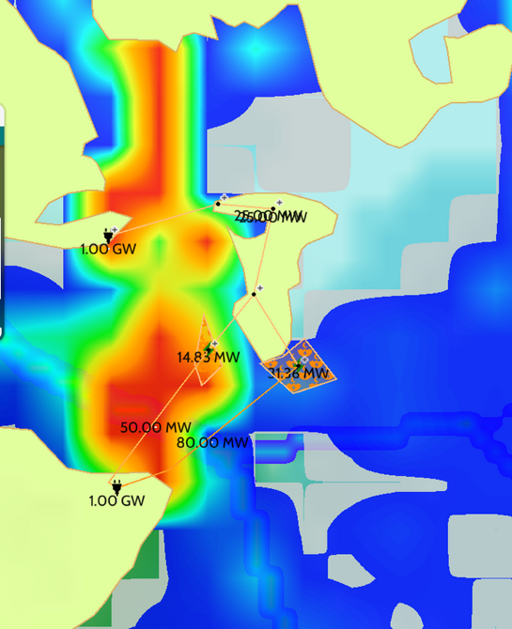
ALTERNATIVE 2 : COMMUNITY POV
LOCATION ANALYTICS
Question:
Response:
Where are areas of high marine use or value to communities that should be treated with caution during cable installation?
Shorelines
Ferry Routes:
Traditional Fishing Grounds
wreck sites
COMMUNITY IMPACT
Question:
Response:
What long-term benefits does the plan offer to nearby communities (e.g., improved energy access or economic opportunities), and how can those be measured or ensured?
Energy for coastal communities
Job creation
Cleaner Energy
Possibility of other investments

Slide 20
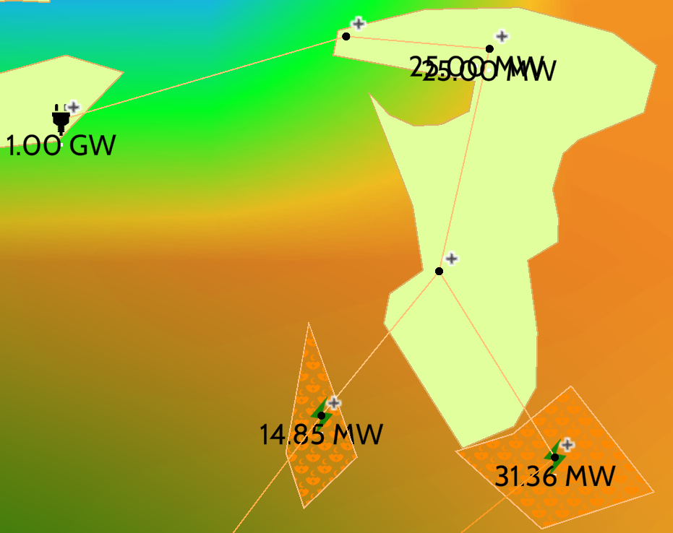

ALTERNATIVE 2: CONSERVATIONIST POV
DESCRIPTIVE:
Brims
⦿
Question:
Response:
⦿
Herstone
What is the current density of benthic invertebrates, sandeels, and large fish along each cable route?
Benthic Invertebrates are at a Medium density.
The Sandeels are at a High density.
Large fish at a Medium density
PREDICTIVE:
Question:
Response:
Burwick
Seals: High risk of disturbance to resting, breeding- due to noise and habitat disruption.
Cetaceans: Potential disruption to communication and navigation from underwater noise.
Biodiversity: Seabed disturbance may reduce benthic species
What are the long-term ecological impacts of cable construction on seals, cetaceans, and biodiversity?
⦿
PRESCRIPTIVE:
Question:
Response:
Which mitigation strategies should be prioritized to reduce ecological damage?
Seasonal timing consideration
Trenchless technology is required
Noise reduction measures to be in place
Pre-construction ecological surveys
Establish buffer zones
Geo-Layers include: Mammals, Marine Protected Areas
Very High to High Seal Density
Medium Seal Density
Low to Very Low Seal Density

Slide 21
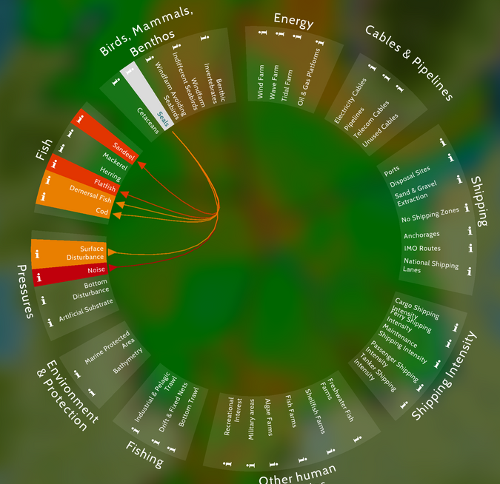
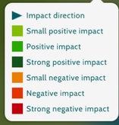
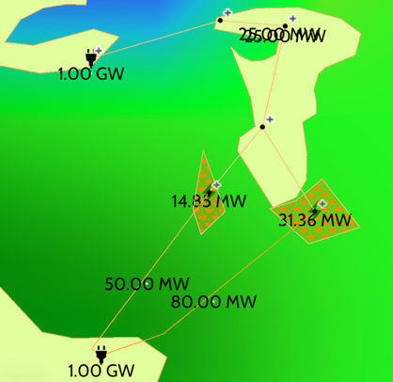
ALTERNATIVE 2: CONSERVATIONIST POV
LOCATION ANALYTICS:
Question:
Response:
Where can cable routes be placed to fully avoid protected areas and high-biodiversity zones?
There is no Marine Protected Area crossed, which is positive.
Minor route adjustment - to reduce impact on dense seal populations.
Need to avoid sandeel hotspots, based on updated ecological surveys.
STAKEHOLDER IMPACT:
Herstone
Question:
Response:
⦿
How can we ensure biodiversity protection through effective monitoring systems during and after the project?
Baseline monitoring:
Real-time construction monitoring:
Post-construction monitoring:
Adaptive management:
Public reporting:
Burwick
⦿
Geo-Layers include: Fish, Macrobenthos, Protected Areas, Biodiversity Indicator

Slide 22
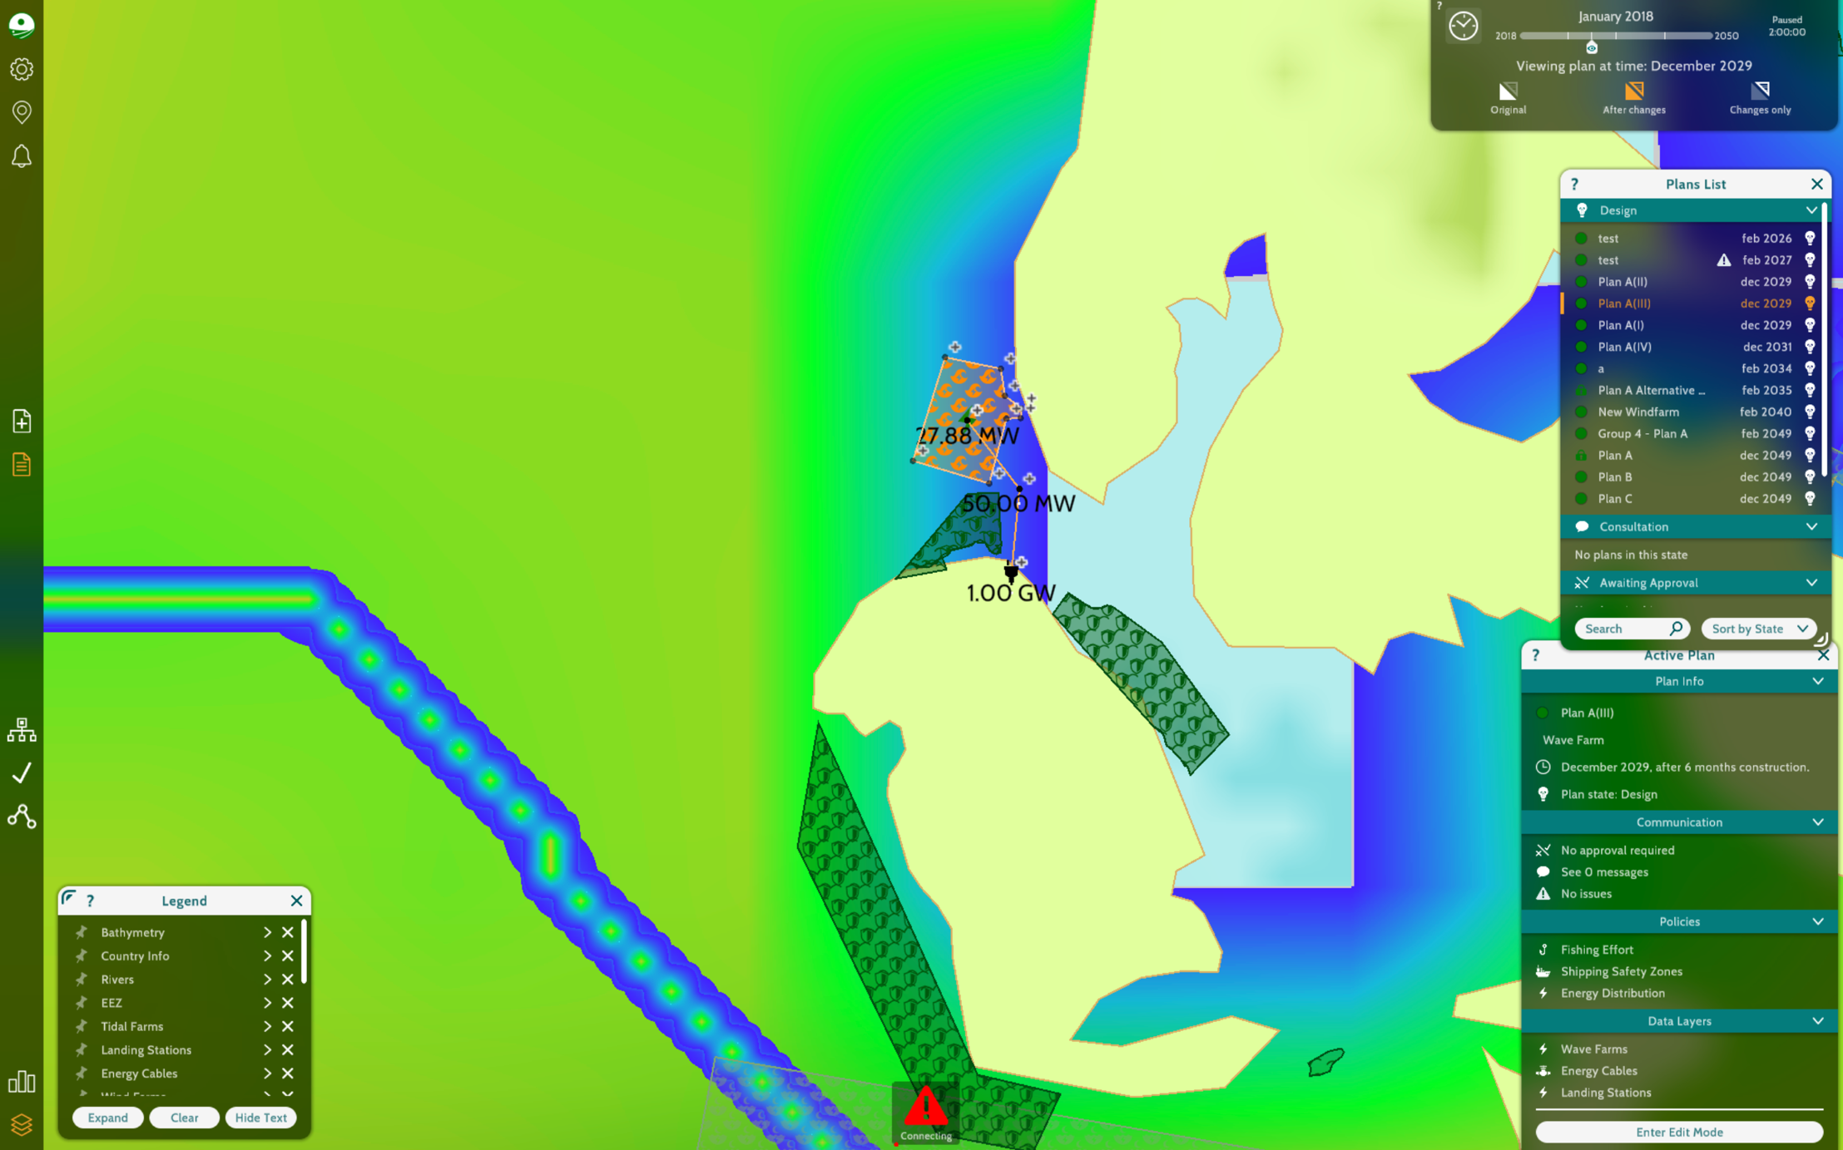
ALTERNATIVE 3: WAVE FARM TO MURRA

Slide 23
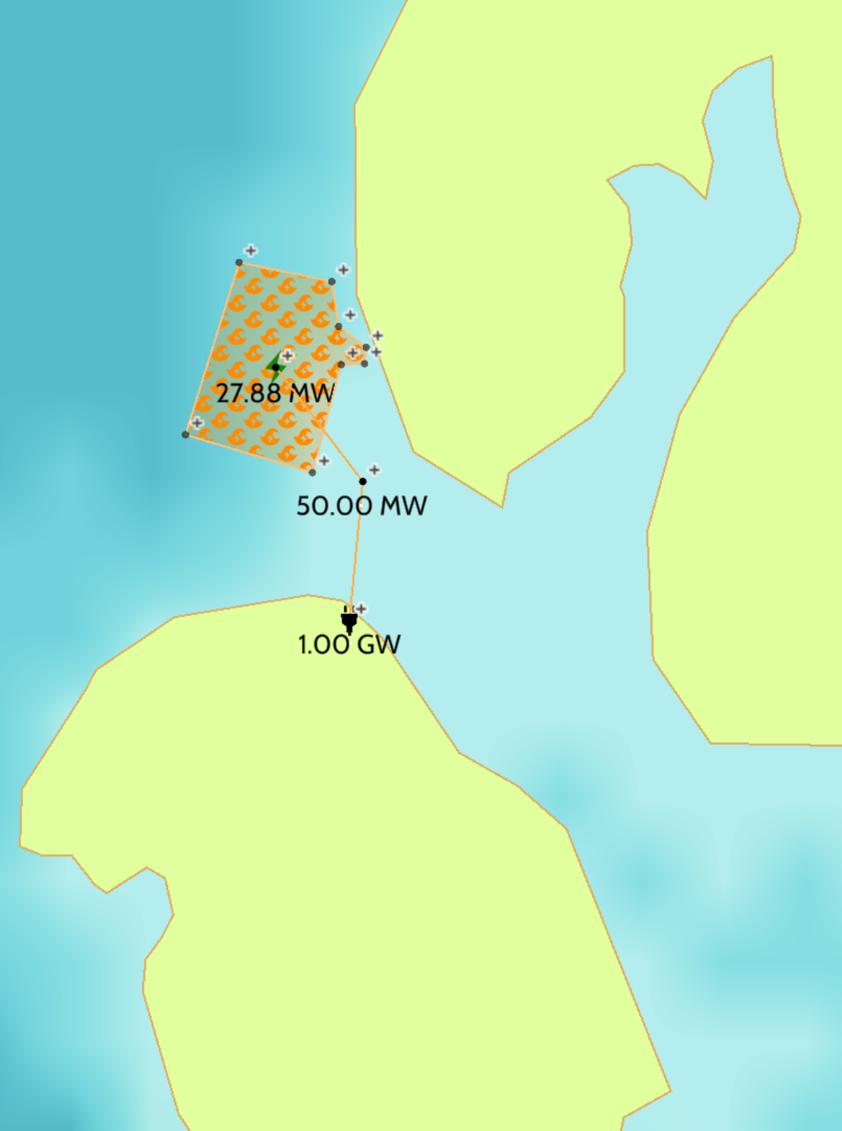
ALTERNATIVE 3: WAVE FARM TO MURRA
Outertown
Wave farm near Outertown
Energy routed directly to Murra (no landing station at Outertown)
Undersea cable from Farm to Murra = 5.64 km
Avoids MPAs, shipping lanes, and fishing zones entirely
Seabed: Hard substrate (requires careful anchoring and planning)
⦿
⦿
Murra
Brims
⦿

Slide 24
ALT 3: ENVIRONMENTAL & TECHNICAL REVIEW
Outertown
⦿
Cleanest environmental profile
Wave energy = minimal marine life interference
1 landing stations (Murra)
Efficient energy delivery
Offers energy autonomy and long-term sustainability
⦿
Murra
Brims
⦿

Slide 25
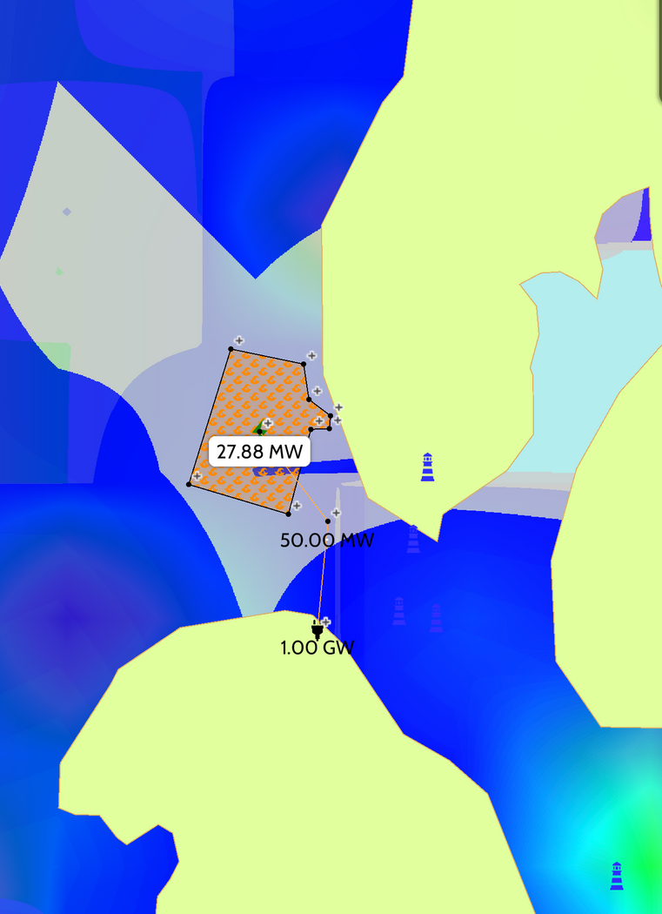
ALTERNATIVE 3 : COMMUNITY POV
DESCRIPTIVE:
Question:
Response:
What marine activities do local communities depend on along the cable route, and how might construction interfere with those activities?
Active marine use: fishing, shipping, recreation
Construction may limit access to these zones
Temporary disruption of traditional marine routes
PREDICTIVE:
Question:
Response:
How might construction or presence of the cable affect marine conditions that support livelihoods, like fish availability or safe access to coastal waters?
Noise & seabed disruption may affect fish
Cable may alter fish migration routes
Small vessels may face safety challenges
STAKEHOLDER TRADE-OFFS
Question:
Response:
What are the trade-offs for communities if this Plan moves forward as designed — in terms of access, safety, and day-to-day activities?
Gains: clean energy, jobs, local growth
Risks: limited fishing, traffic conflicts
Need for balanced zoning & stakeholder input

Slide 26
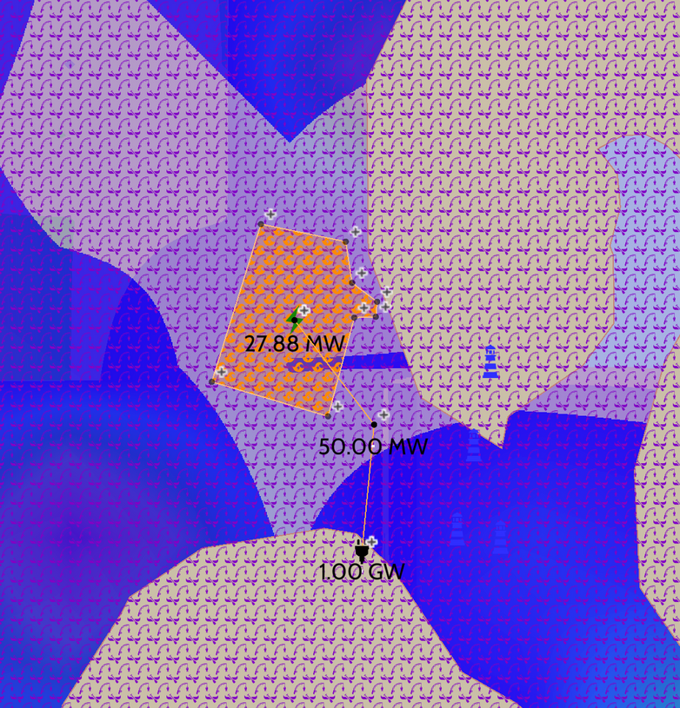
ALTERNATIVE 3 : COMMUNITY POV
LOCATION ANALYTICS
Question:
Response:
Where are areas of high marine use or value to communities that should be treated with caution during cable installation?
Cable crosses fishing & shipping zones
Sensitive ecological zones visible (biodiversity, birds, mammals)
Requires careful routing and seasonal planning
COMMUNITY IMPACT
Question:
Response:
What long-term benefits does Plan A offer to nearby communities (e.g., improved energy access or economic opportunities), and how can those be measured or ensured?
Delivers up to 1 GW clean wave energy
Creates jobs & supports energy access
Measurable via jobs, usage data & surveys

Slide 27
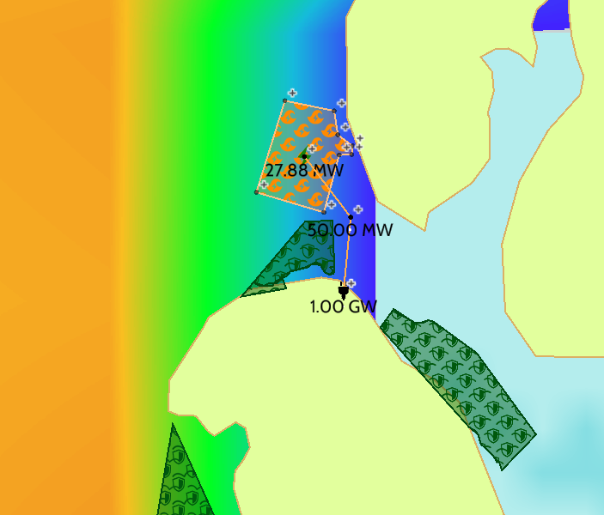
ALTERNATIVE 3: CONSERVATIONIST POV
DESCRIPTIVE:
Question:
Response:
What is the current density of benthic invertebrates, sandeels, and large fish along each cable route?
Very low benthic invertebrate density
Very low sandeel presence
Very low large fish density
Route avoids marine protected areas
Outertown
PREDICTIVE:
Question:
Response:
What are the long-term ecological impacts of cable construction on seals, cetaceans, and biodiversity?
Low impact on seals (route in low-density area)
Minimal disturbance to biodiversity
No major marine mammal habitats affected
Murra
PRESCRIPTIVE:
Question:
Response:
Which mitigation strategies should be prioritized to reduce ecological damage?
Use low-noise cable-laying techniques
Avoid marine mammal breeding seasons
Monitor ecological impacts during & after build
Geo-Layers include: Mammals, Marine Protected Areas
Very High to High Seal Density
Medium Seal Density
Low to Very Low Seal Density

Slide 28
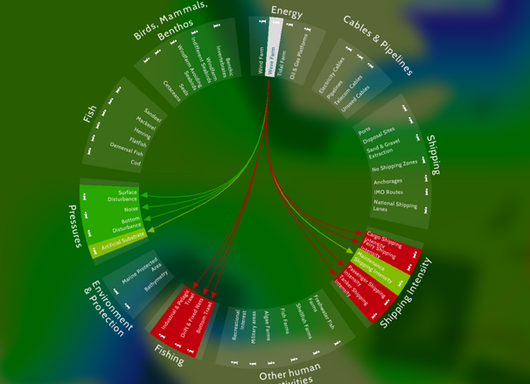
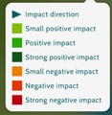
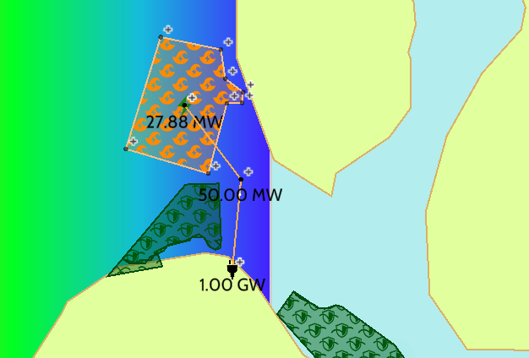
ALTERNATIVE 3: CONSERVATIONIST POV
LOCATION ANALYTICS:
Question:
Response:
Where can cable routes be placed to fully avoid protected areas and high-biodiversity zones?
Plan 3 avoids all marine protected areas
Route passes through low biodiversity zones
Specifically large fish
Ideal for minimizing ecological disruption
STAKEHOLDER IMPACT:
Wave Farms = No Impact on Fish, Birds, Mammals, Benthos, & add no additional pressures on the marine ecosystem
Question:
Response:
How can we ensure biodiversity protection through effective monitoring systems during and after the project?
Implement pre- and post-construction biodiversity surveys
Use automated monitoring tools
ex. sonar, acoustic sensors
Enforce adaptive/agile management if unexpected impacts occur
Geo-Layers include: Fish, Macrobenthos, Protected Areas, Biodiversity Indicator

Slide 29
TRADE-OFF MATRIX SUMMARY
Criteria | Plan A | Alt 1 | Alt 2 | Alt 3
MPA Conflict | ❌ | ✅ | ✅ | ✅
Fishing Conflict | ❌ | ⚠️ | ⚠️ | ✅
Energy Independence | ❌ | ✅ | ⚠️ | ✅
Infrastructure Simplicity | ⚠️ | ✅ | ❌ | ⚠️
Cost & Maintenance | ⚠️ | ✅ | ❌ | ✅
Alt 3 avoids all conflict zones
Alt 1 scores high, but has fishing risk
Plan A performs poorly across the criteria
Alt 2 is complex and lacks island autonomy

Slide 30
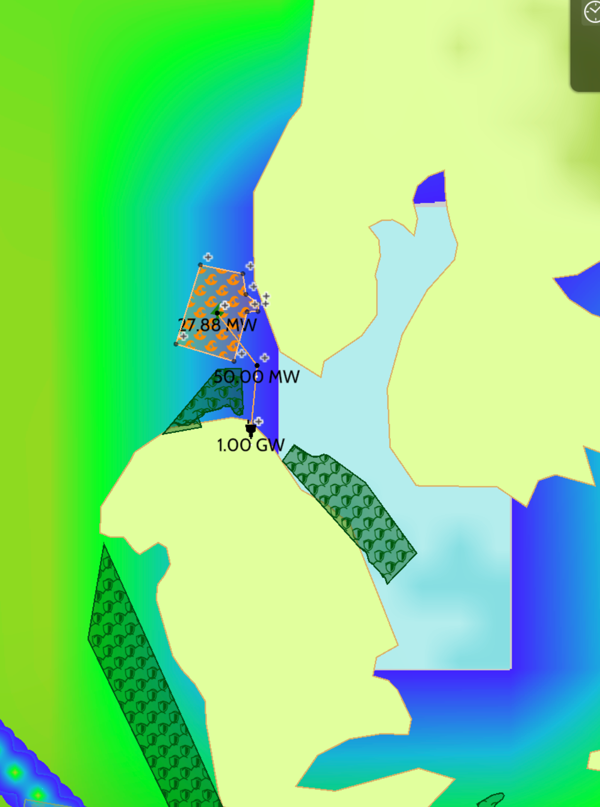
DEVELOPER RECOMMENDATION
After presenting all data and hearing stakeholder voices we recommend Alternative 3:
Environmentally clean
Technically viable
Respects conservation goals
Empowers the Brims community
“We believe this is the most balanced, future-proof solution.”
Outertown
⦿
⦿
Murra
Brims
⦿

